Slide 1
Chapter 6: Normal Distribution
Textbook: Ahmad Daryanto, Introduction to Quantitative Research Methods for Marketing With SPSS and R: Tools and Techniques, Routledge. 2024

Slide 2
Learning Objectives
Understand the characteristics of a normal distribution.
Know how to obtain a standard normal distribution from a normal distribution.
Know how to use SPSS to create an Histogram.
Know how to use SPSS macros to find areas under a normal curve.
Know how to standardize a variable.

Slide 3
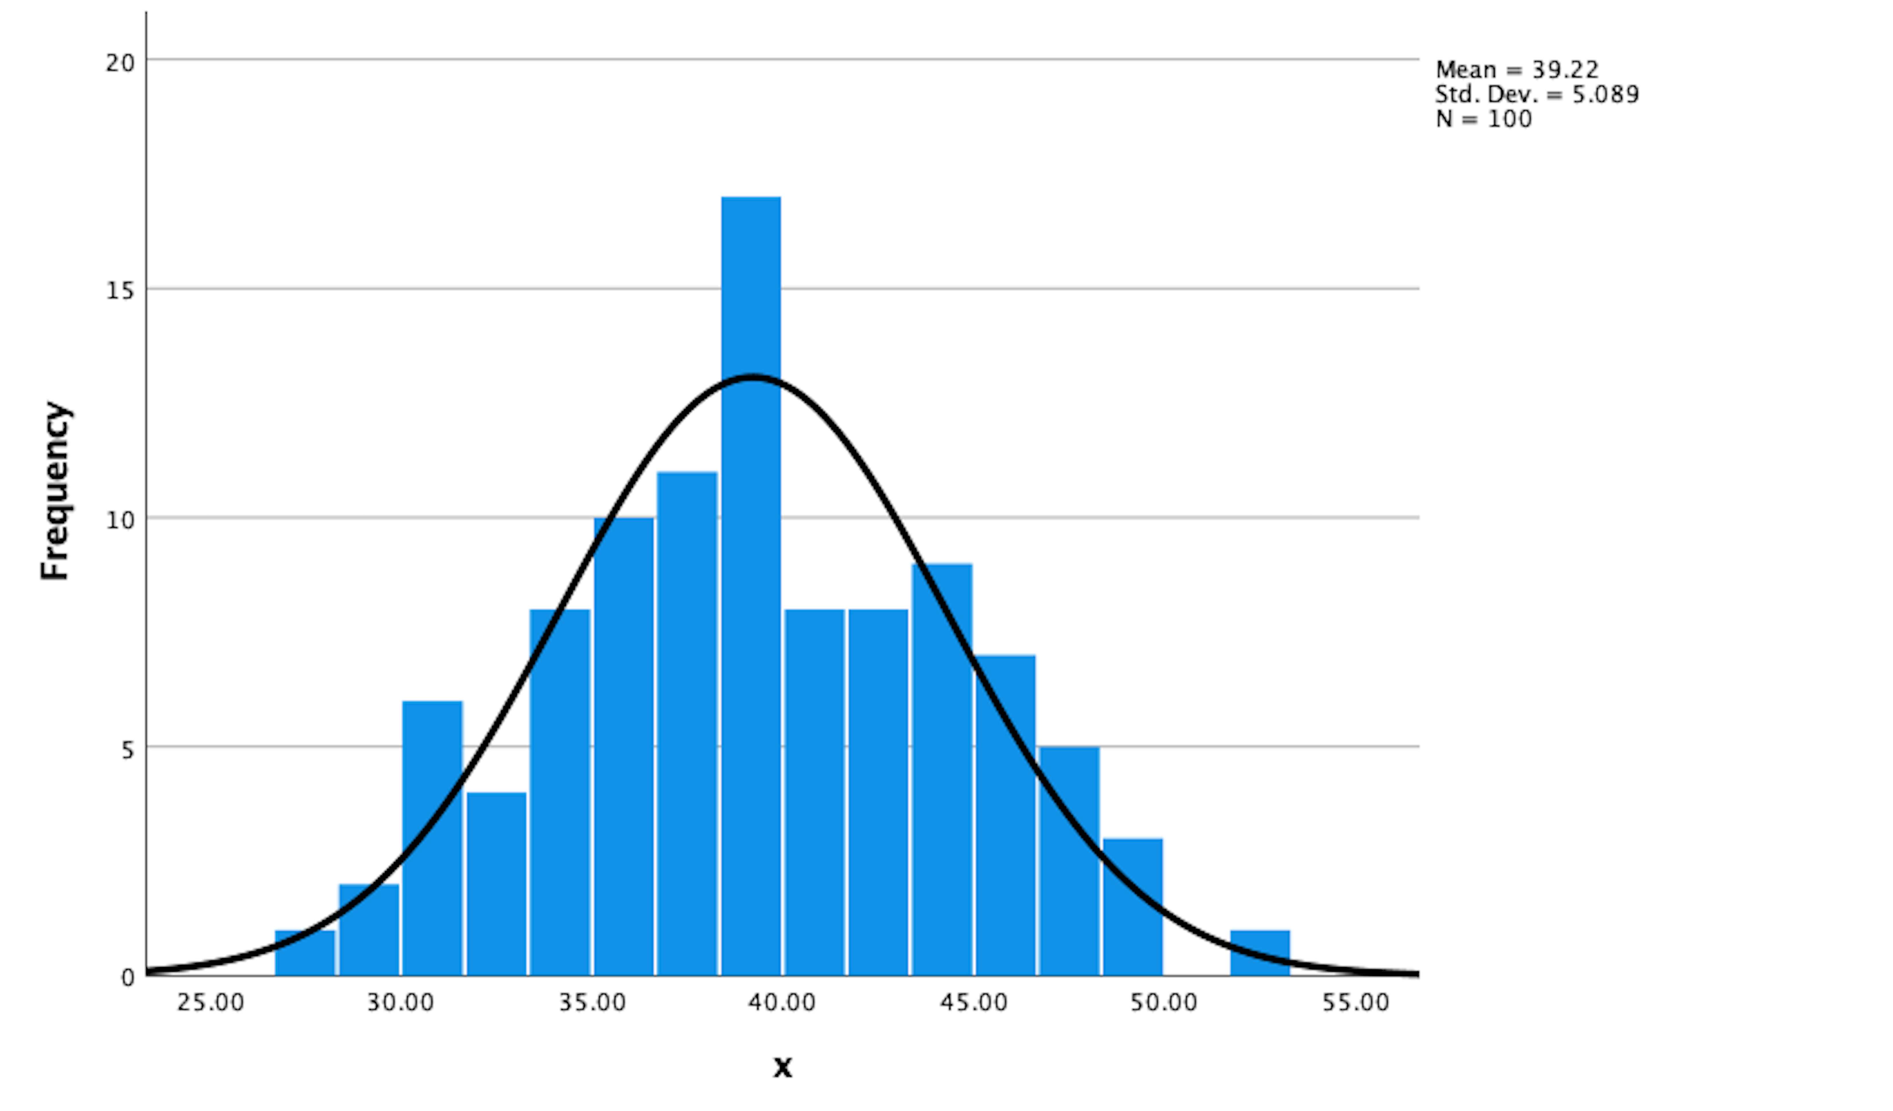
A Histogram Of Weekend Spending
The smooth bell-shaped curve superimposed in the histogram is a normal distribution curve, also known as a Gaussian distribution named after Carl Friedrich Gauss, the famous 18th century German physicist and mathematician (1777 - 1855).

Slide 4
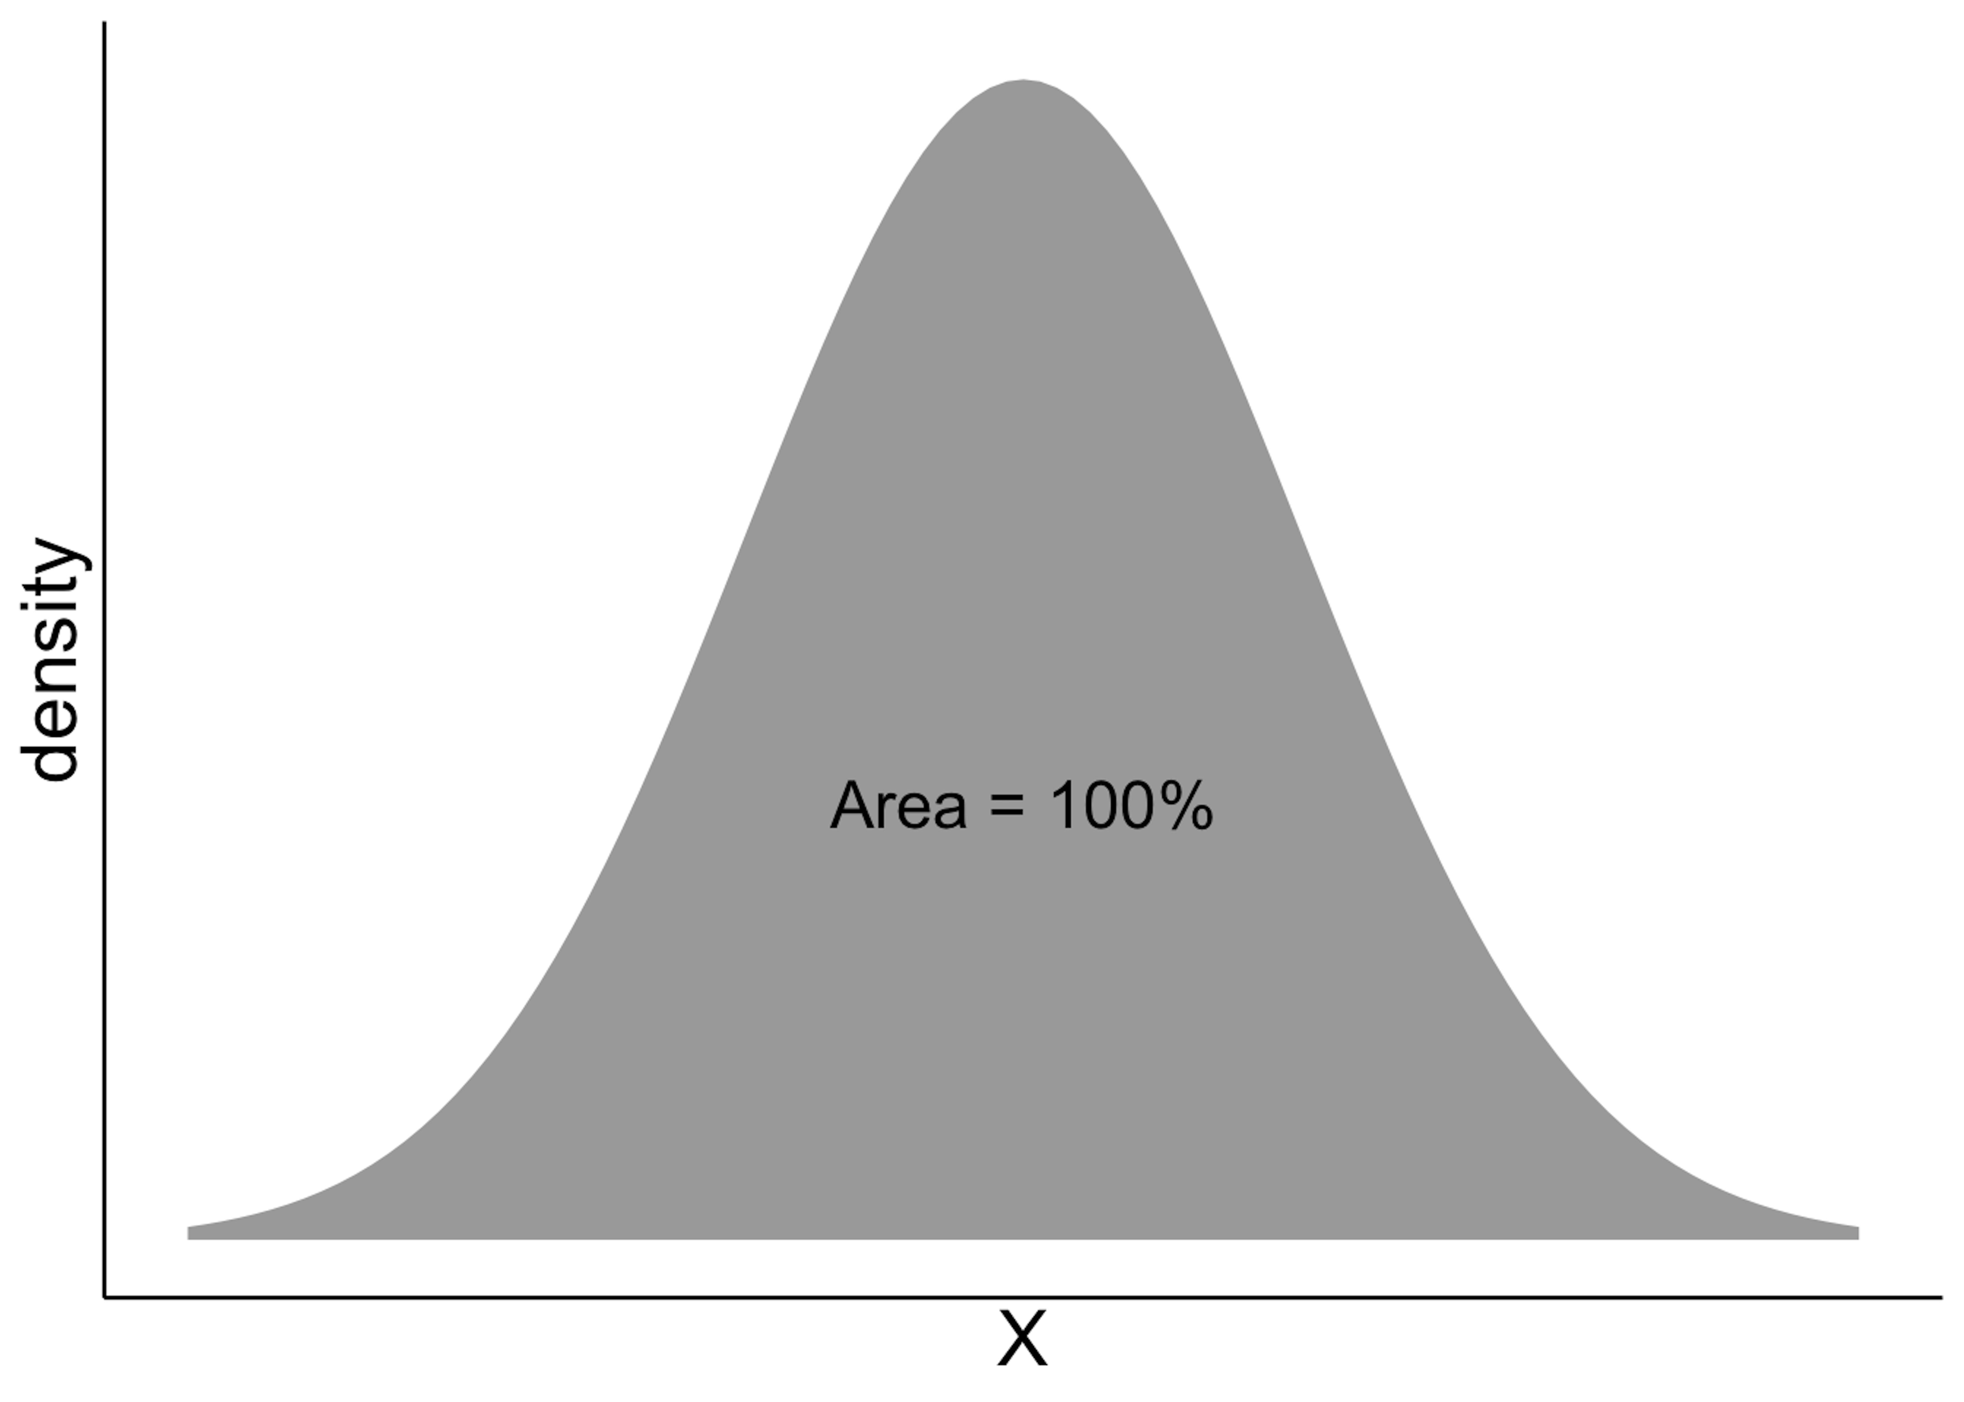
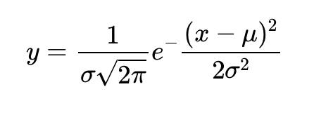
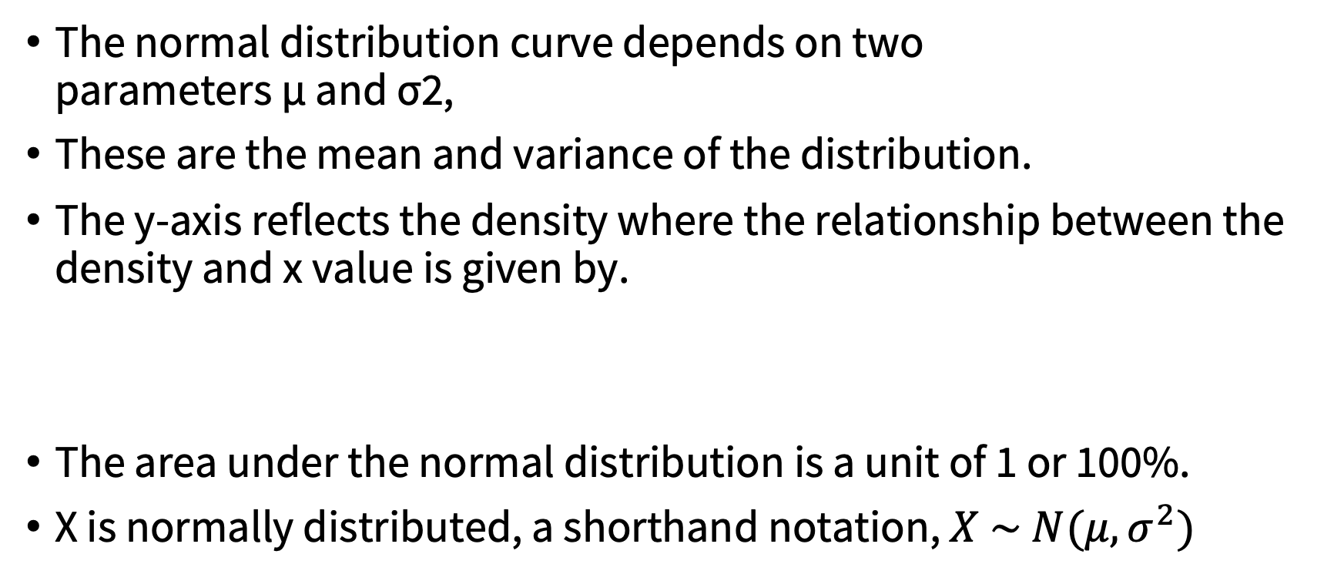
Normal Distribution
The normal distribution curve depends on two parameters μ and σ2,
These are the mean and variance of the distribution.
The y-axis reflects the density where the relationship between the density and x value is given by.
The area under the normal distribution is a unit of 1 or 100%.
X is normally distributed, a shorthand notation, $X \sim N(μ, σ^{2})$

Slide 5
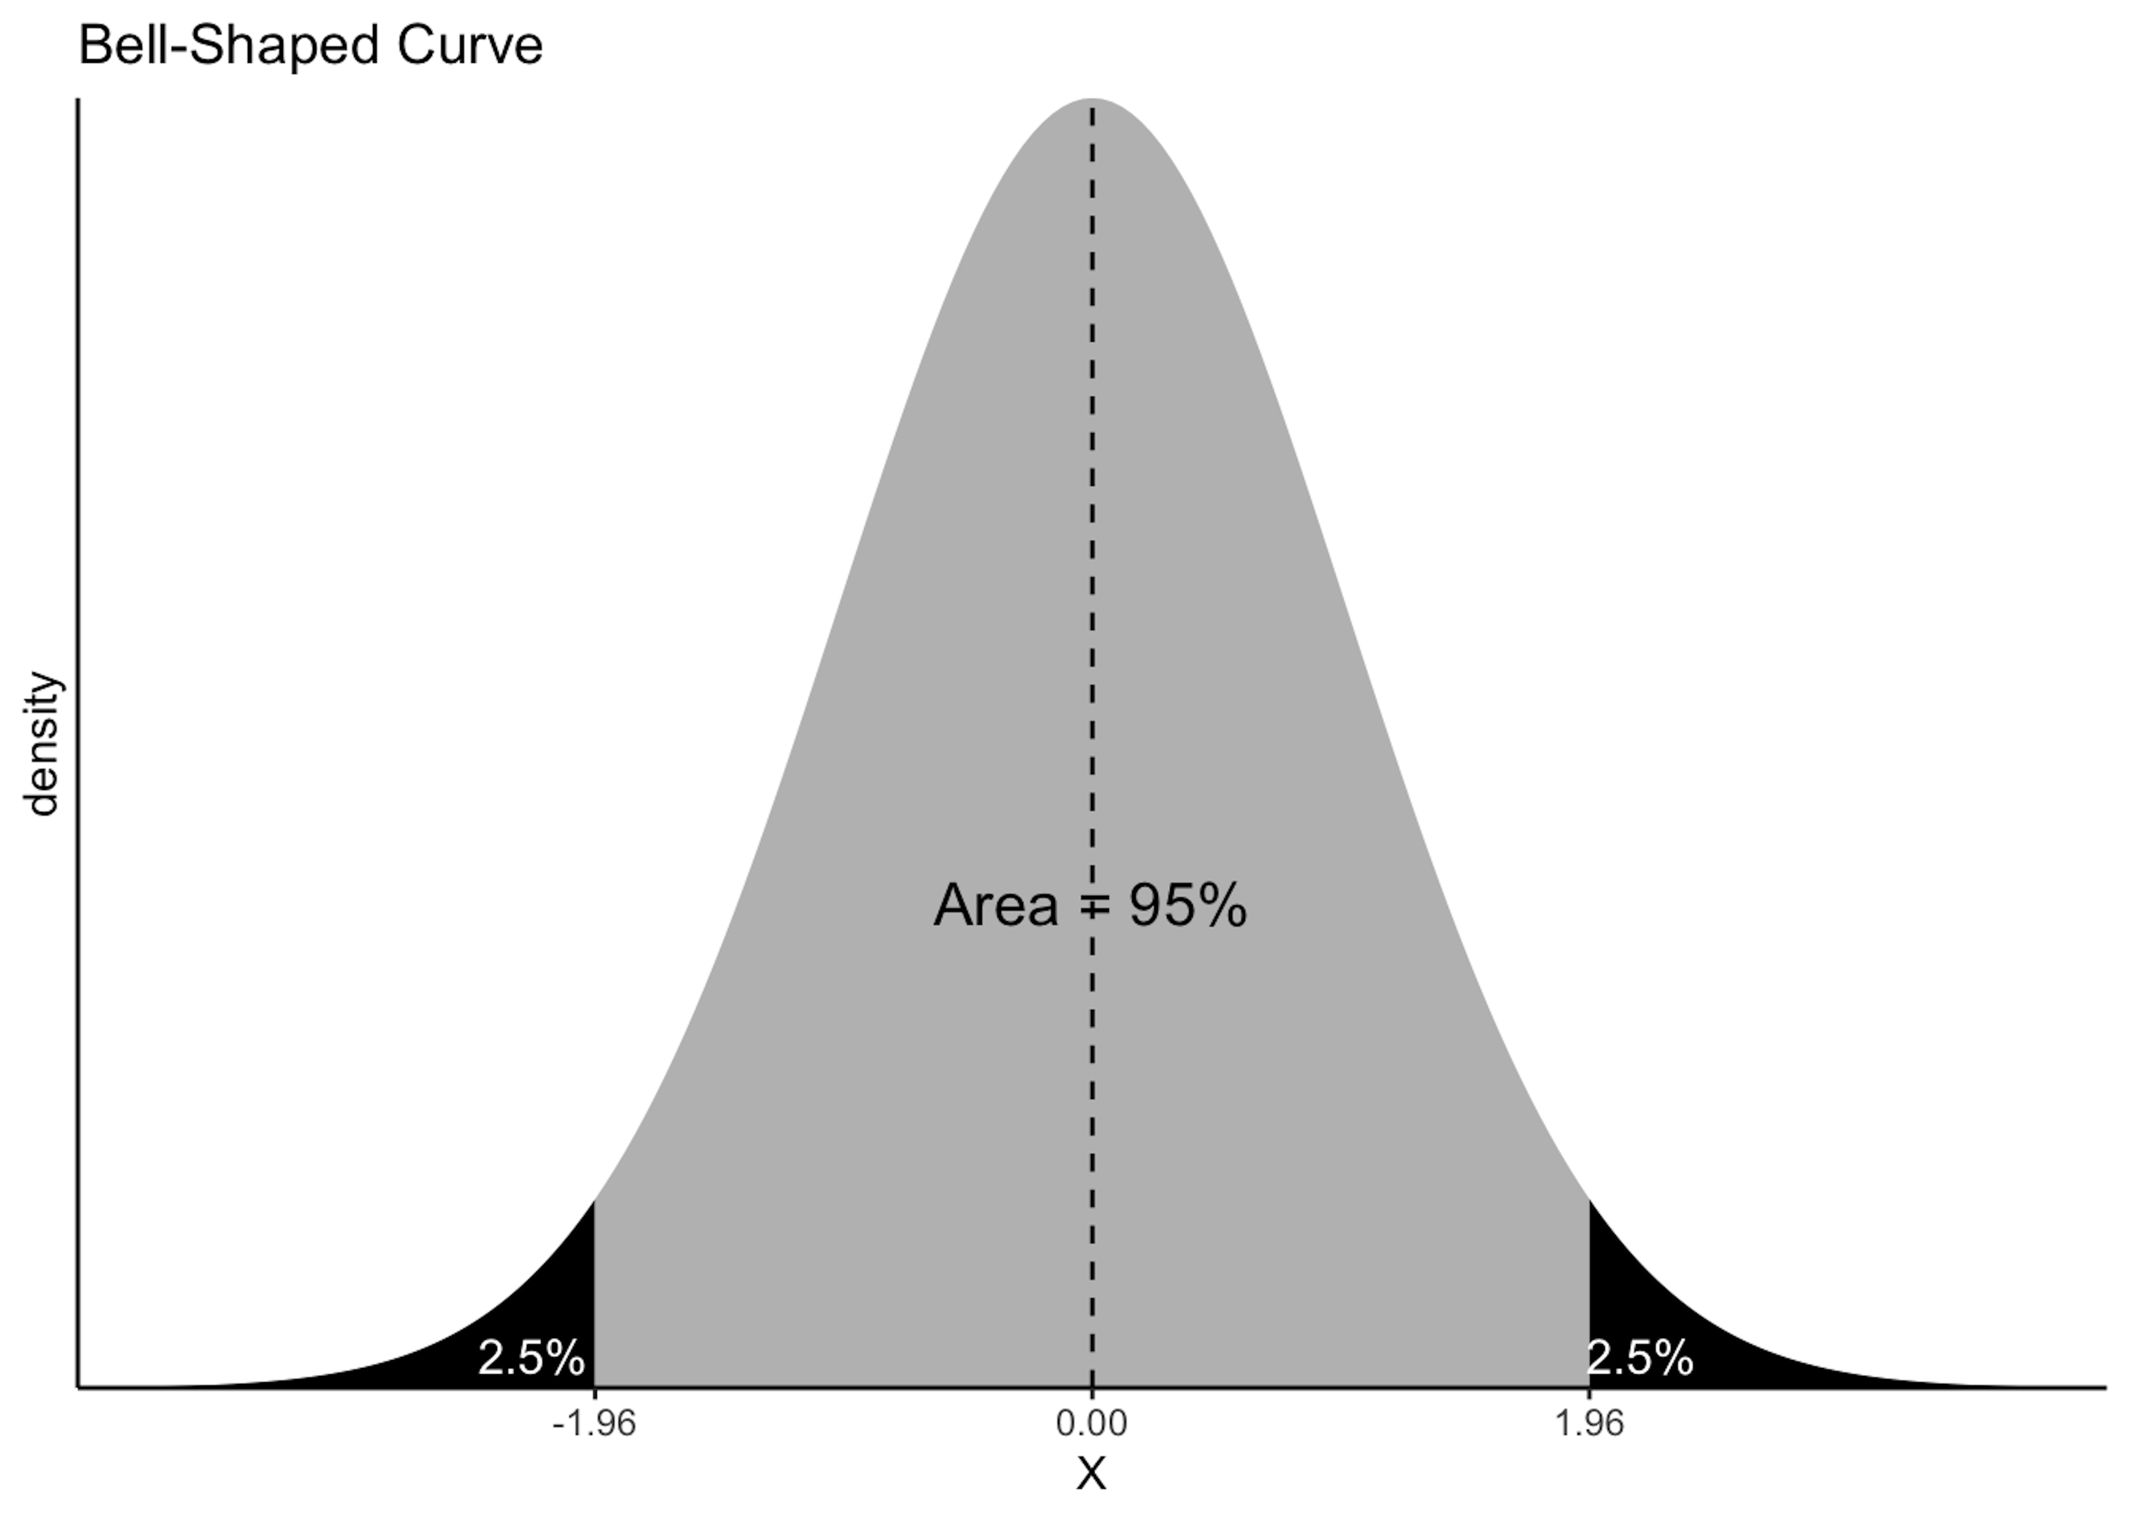
A Standard Normal Distribution
A normal distribution having mean of 0 and standard deviation of 1 denoted by X∼N(0,1), is called a standard normal distribution or z-distribution.
The small area under the curve to the left of -1.96 (left tail) is 2.5%, and similarly the area to the right of 1.96 (right tail) is 2.5% of the total area.

Slide 6
Finding Area under a Normal Curve
I have written an SPSS macro NORMDIST to find an area under a normal curve.
Install NORMDIST.spd
Analyze → NORMDIST by Ahmad Daryanto.

Slide 7
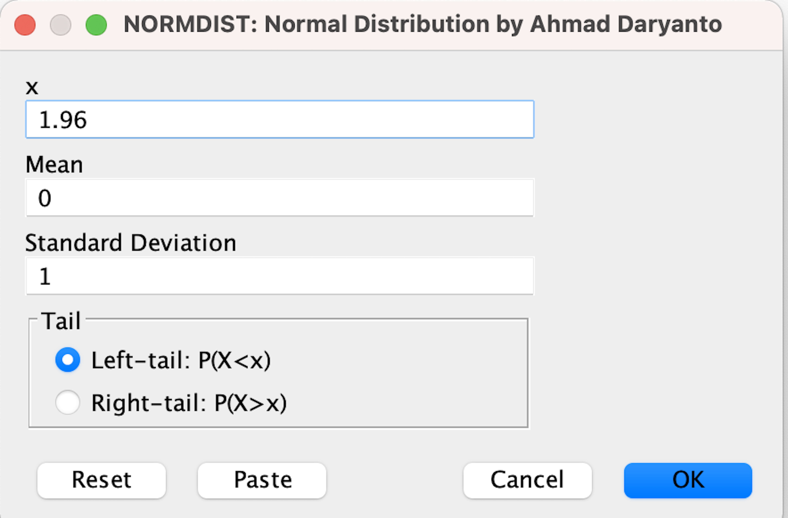
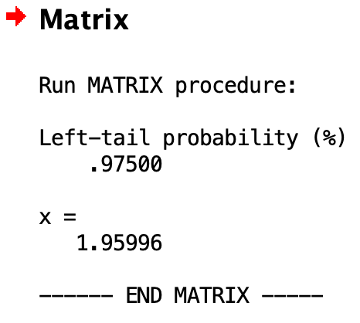
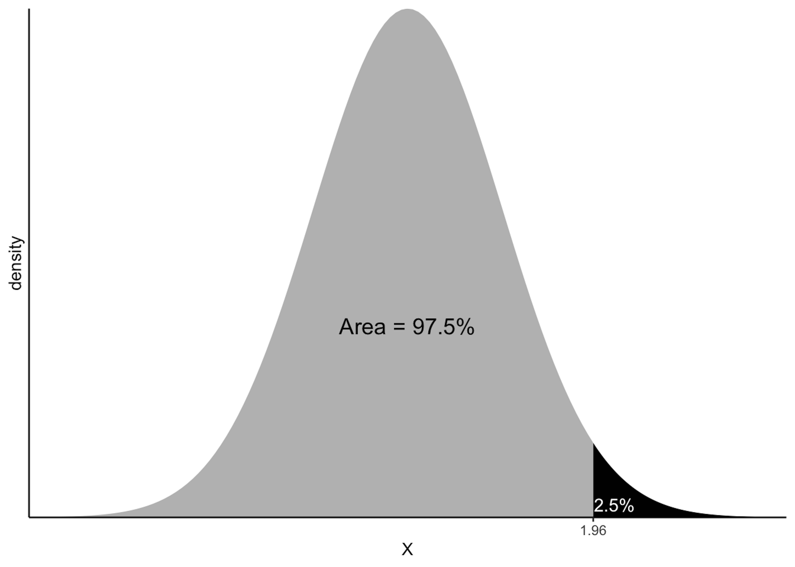
R Action:
pnorm(1.96, mean = 0, sd = 1)

Slide 8
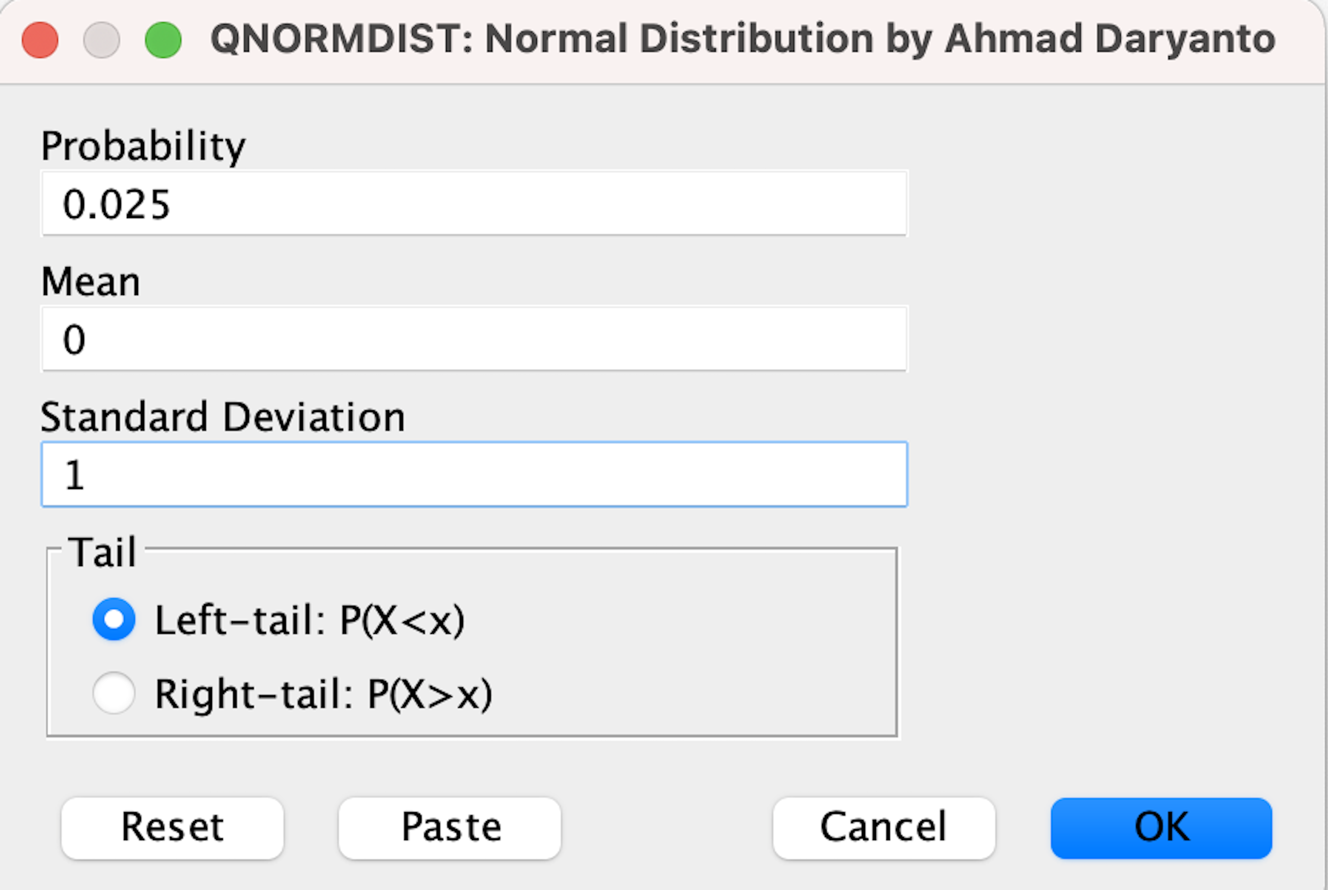
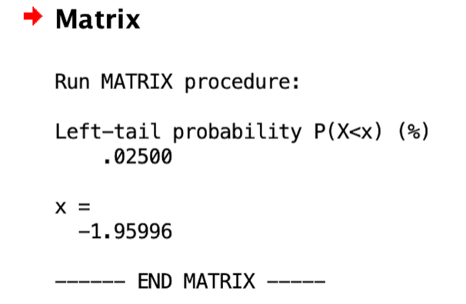
Finding x values for certain areas under a Normal curve
I have written an SPSS macro QNORMDIST
R Action
qnorm(0.025, mean = 0, sd = 1, lower.tail=TRUE)

Slide 9
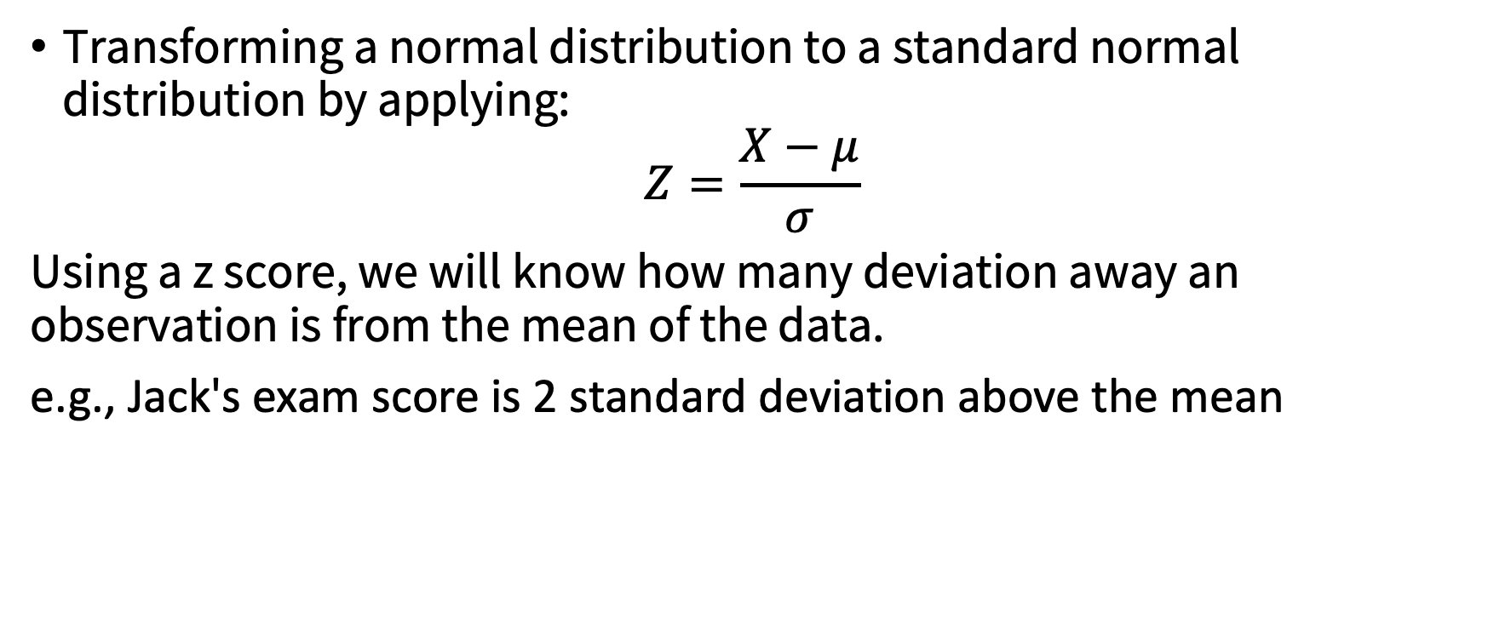
Z-Transformation
Transforming a normal distribution to a standard normal distribution by applying:
$$Z=\frac{X−μ}{σ}$$
Using a z score, we will know how many deviation away an observation is from the mean of the data.
e.g., Jack's exam score is 2 standard deviation above the mean

Slide 10
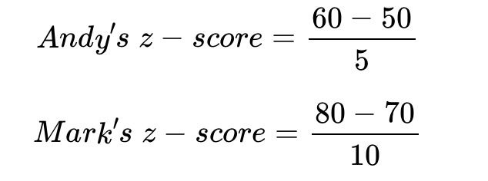
Illustration
Suppose that Andy is a manager of a car showroom in the UK who managed to sell 60 cars in a month. The sales mean score calculated from all managers in the country is 50 cars with a standard deviation of 5. Mark is the car manager of the same company in Germany. Mark managed to sell 80 cars in that month. The sales mean score in Germany is 70 cars with a standard deviation of 10. Assuming sales in both countries are normally distributed, which managers perform better relative to their peers in the same country?

Slide 11
SPSS Action: Creating Z-scores in SPSS
DESCRIPTIVES VARIABLES=Sales Adv
/SAVE
/STATISTICS=MEAN STDDEV MIN MAX.

Slide 12
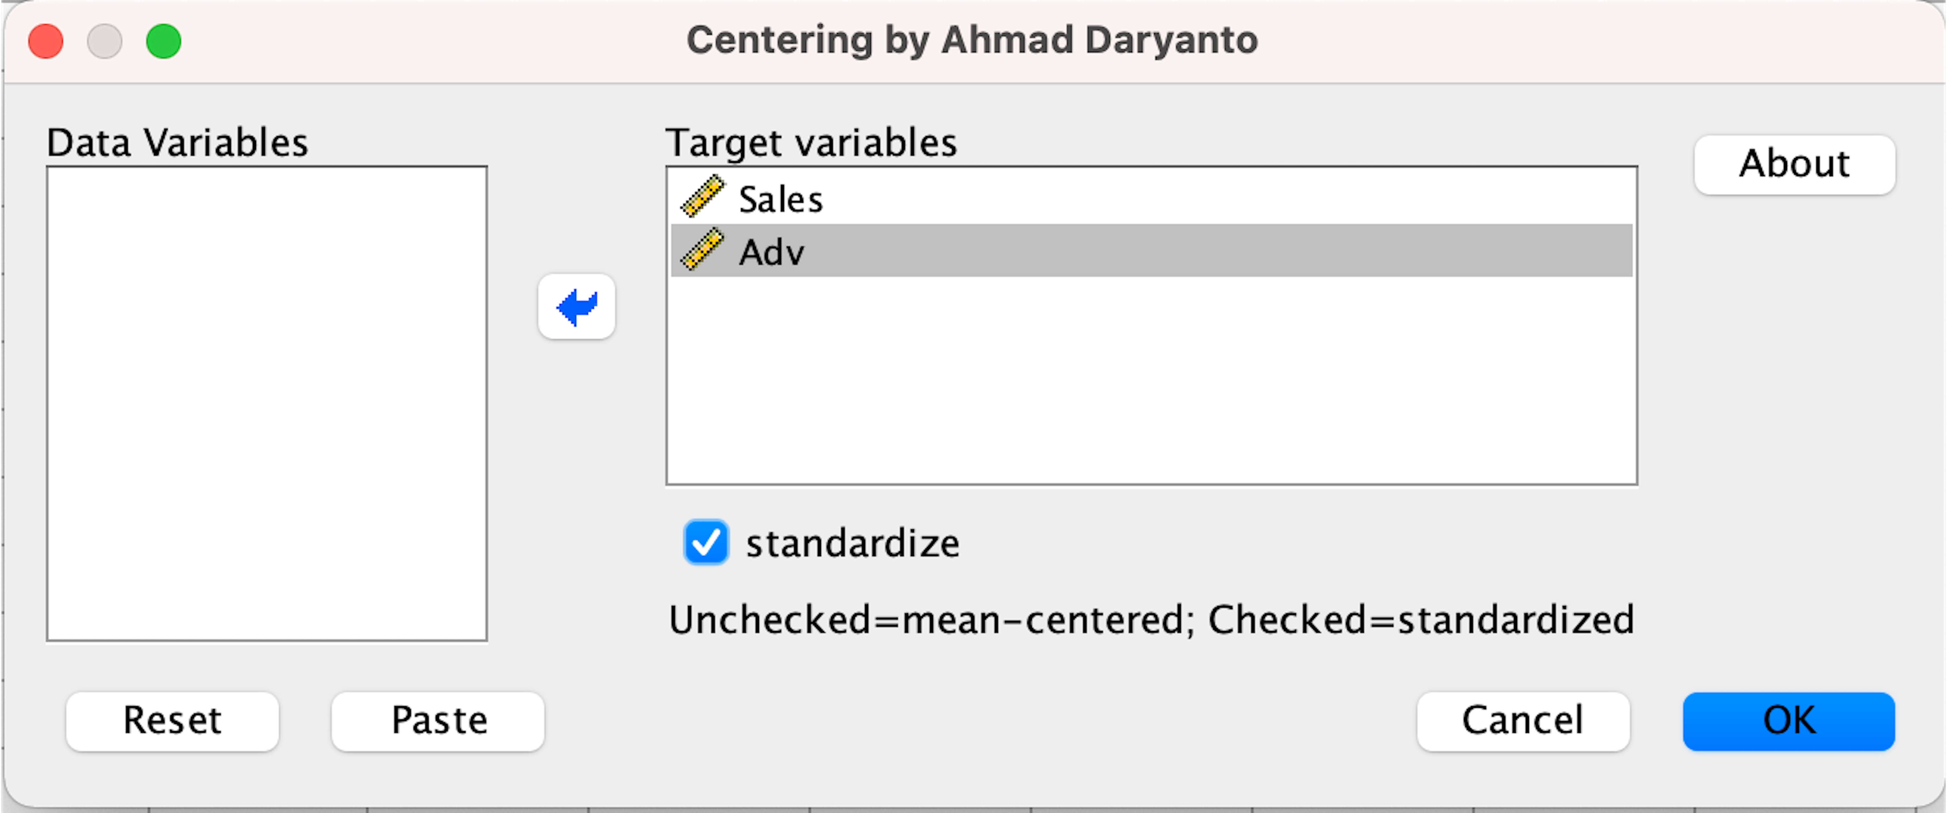
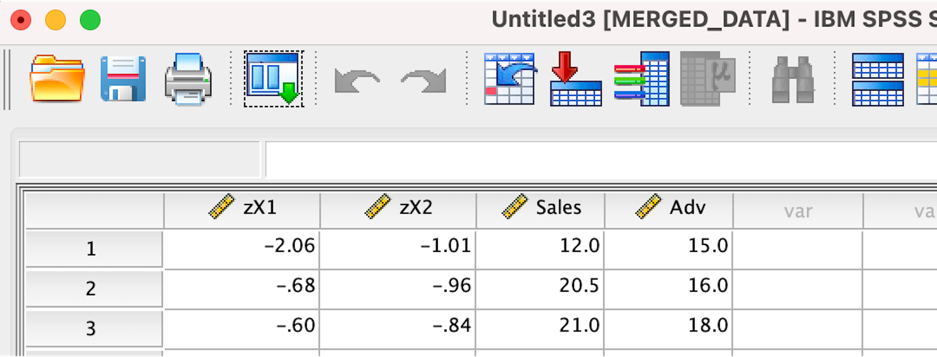
Centering Macro
Install CENTERING.spd

Slide 13
R Action
# Target value to standardize
x <- 60
# Mean and standard deviation of the distribution
mean_value <- 50
sd_value <- 5
# Calculate the Z-score (standardized value)
z_score <- (x - mean_value) / sd_value
print(z_score)

Slide 14
Writing a function
function_name <- function(parameters){
function body
}
# My z-score function
zscore <- function(target, themean, thesd){
(target - themean) / thesd
}
print(zscore(60, 50, 5))

Slide 15
Skewness
Skewness is a measure of (a)symmetry.
A normal distribution is perfectly symmetrical. The skewness value of a normal distribution is zero.
. For a left-tailed distribution– the flatness of the distribution is on the left, the skewness value is negative.
For right-tailed distribution – the flatness of the distribution is on the right, the skewness value is positive

Slide 16
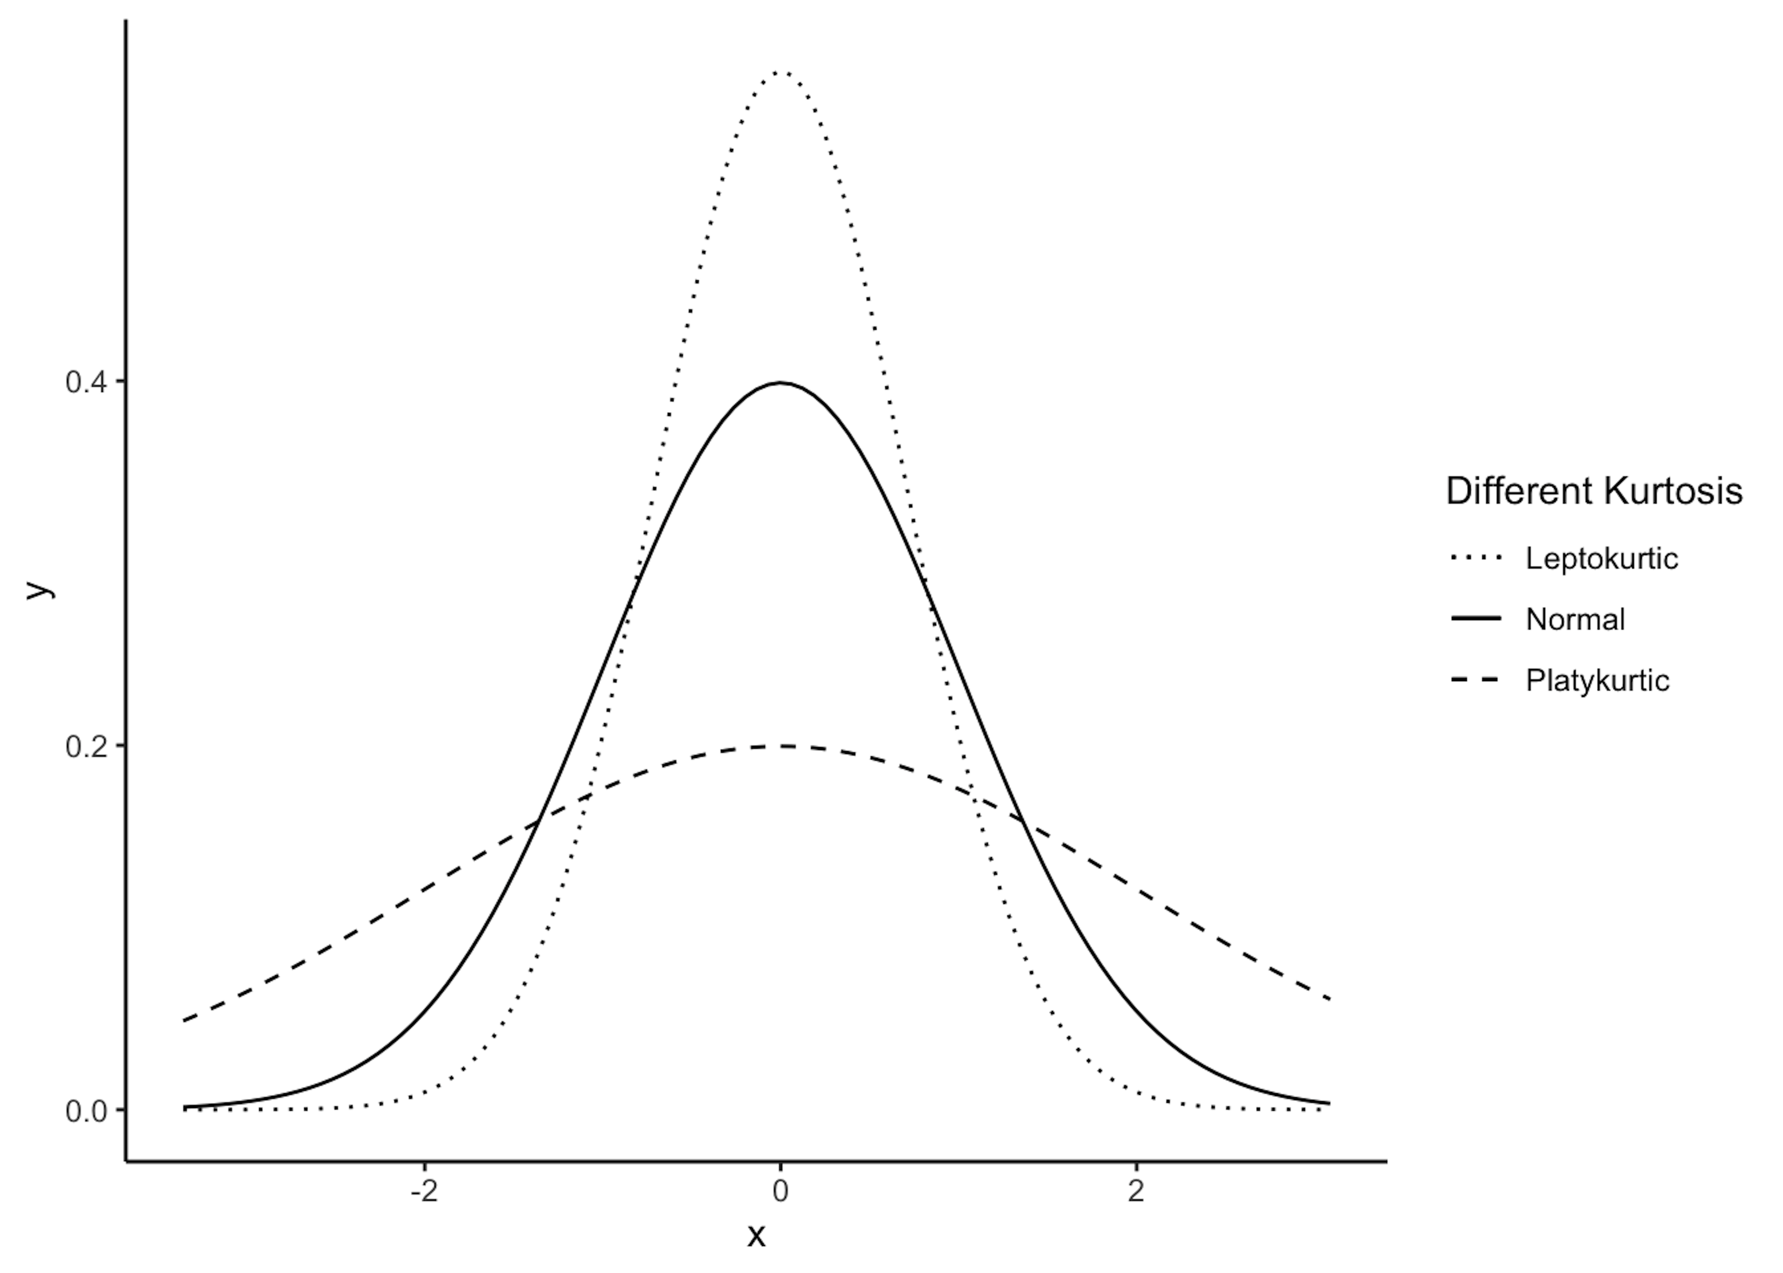
Kurtosis
Kurtosis is a measure of how peaked or flat a distribution is. For a a normal distribution, kurtosis value is equal to 3. If the kurtosis value is less than 3, the distribution is called platykurtic, whilst if the kurtosis value is greater than 3, it is called leptokurtic.

Slide 17
SPSS Action
/STATISTICS=MEAN STDDEV MIN MAX KURTOSIS SKEWNESS.
R Action
install.packages("moments")
library(haven)
library(moments)
dat <- read_sav("/Users/ahmaddaryanto/Documents/Data1/spending.sav")
# skewness
skewness(dat$amount)
# kurtosis
kurtosis(dat$amount)

Slide 18
Empirical and Theoretical Distribution
When you construct a frequency distribution from data that you had collected, the distribution is empirical. If you create a distribution using a mathematical formula (e.g., the normal distribution formula), it produces a theoretical distribution with a curve that looks very smooth. We never have such a perfect normal curve from an empirical data. In research, sometimes the interest lies in finding how close an empirical distribution is to a theoretical distributions. In other words, can we fit a theoretical distribution to an empirical distribution? The activity is called curve-fitting.

